Slide 1


The Three States
Committed
Modified
Staged
Fig. 2: Working directory, staging area, git directory

Slide 2
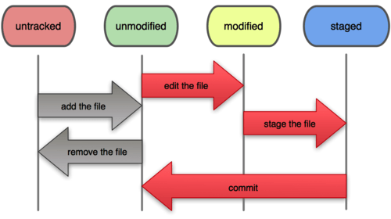
File Status Life Cycle
Fig. 3: The life cycle of the status of the files

Slide 3

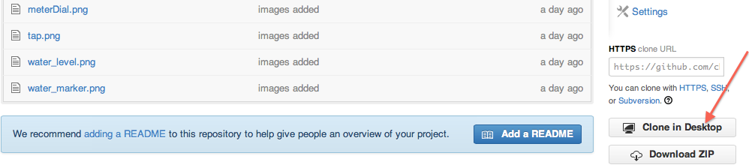
Fork and Clone
Fork: To create a copy that can be modified independently.
Fig. 4: Forking a repository
Clone: To create a local copy of the source code from the source control.
Fig. 5: Cloning a repository

Slide 4
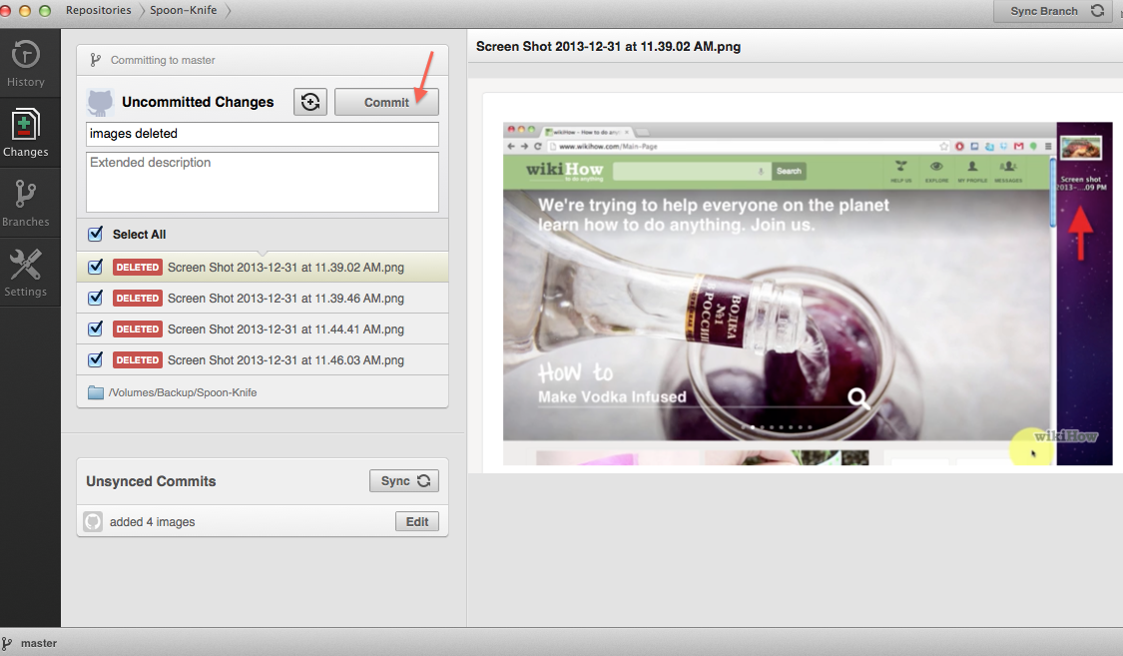
Commit
Safely stores data in local repository.
Fig. 6: Committing changes

